Slide 1
Bug Report

Slide 2
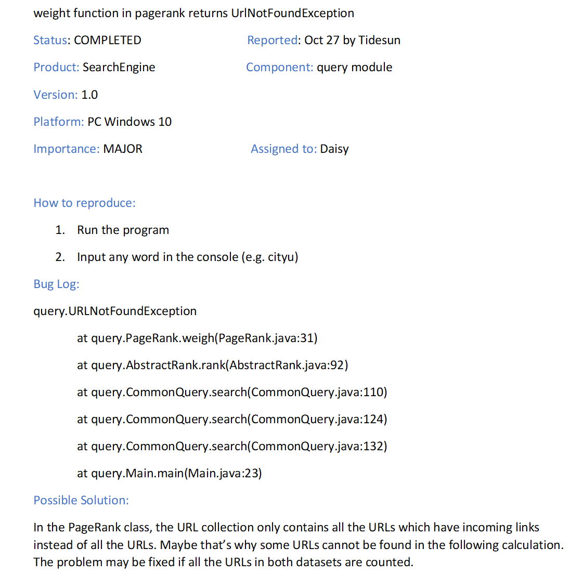
Bug One
Unexpected Exception

Slide 3
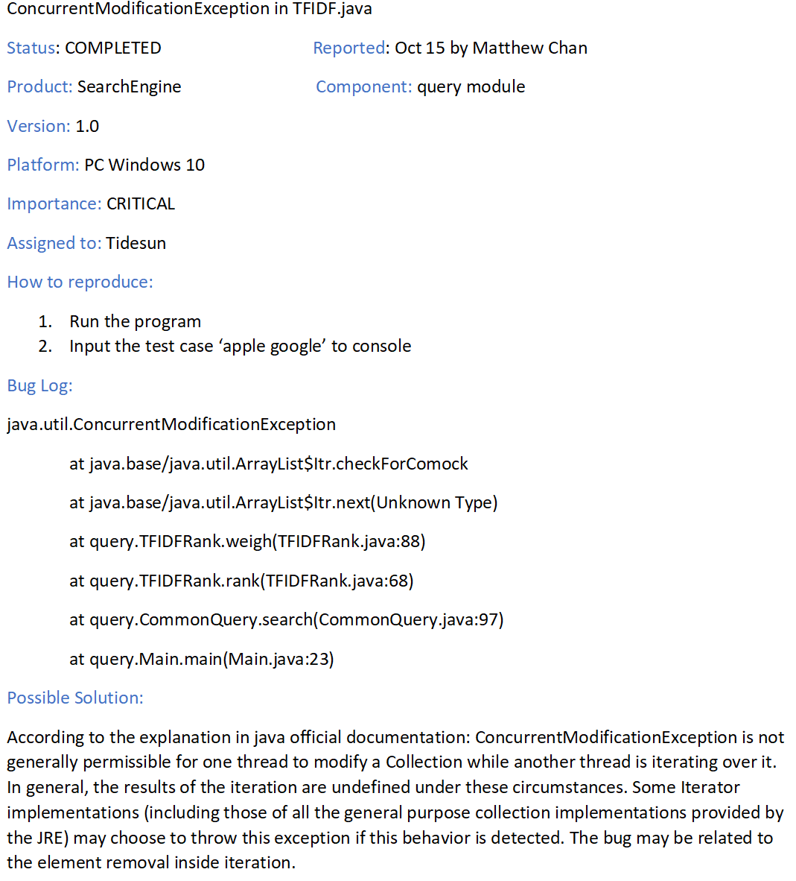
Bug Two
Exception because of design of Java language

Slide 4
Test Organization

Slide 5
Query
CommonQuery
AbstractRank
TFIDF
PageRank

Slide 6
Pre-process
ExtractModuleAbstract
ExtractBodyModule
ExtractTitleModule
ExtractLinkModule
StringMapModule
ForwardIndexModule
InvertedIndexModule

Slide 7


Pre-process
ExtractModuleAbstract
ExtractModuleAbstract
ExtractBodyModule
ExtractBodyModule
ExtractTitleModule
ExtractTitleModule
ExtractLinkModule
ExtractLinkModule
StringMapModule
StringMapModule
Unit Testing
ForwardIndexModule
ForwardIndexModule
InvertedIndexModule
InvertedIndexModule

Slide 8

Pre-process
ExtractModuleAbstract
ExtractModuleAbstract
ExtractBodyModule
ExtractBodyModule
ExtractTitleModule
ExtractTitleModule
ExtractLinkModule
ExtractLinkModule
StringMapModule
StringMapModule
Unit Testing
ForwardIndexModule
ForwardIndexModule
InvertedIndexModule
InvertedIndexModule

Slide 9

Pre-process
ExtractModuleAbstract
ExtractModuleAbstract
ExtractBodyModule
ExtractBodyModule
ExtractTitleModule
ExtractTitleModule
ExtractLinkModule
ExtractLinkModule
StringMapModule
StringMapModule
Integration Testing
ForwardIndexModule
ForwardIndexModule
InvertedIndexModule
InvertedIndexModule

Slide 10

Pre-process
ExtractModuleAbstract
ExtractModuleAbstract
ExtractBodyModule
ExtractBodyModule
ExtractTitleModule
ExtractTitleModule
ExtractLinkModule
ExtractLinkModule
StringMapModule
StringMapModule
Unit Testing
ForwardIndexModule
ForwardIndexModule
InvertedIndexModule
InvertedIndexModule

Slide 11

Pre-process
ExtractModuleAbstract
ExtractModuleAbstract
ExtractBodyModule
ExtractBodyModule
ExtractTitleModule
ExtractTitleModule
ExtractLinkModule
ExtractLinkModule
StringMapModule
StringMapModule
Integration Testing
ForwardIndexModule
ForwardIndexModule
InvertedIndexModule
InvertedIndexModule

Slide 12

Pre-process
ExtractModuleAbstract
ExtractModuleAbstract
ExtractBodyModule
ExtractBodyModule
ExtractTitleModule
ExtractTitleModule
ExtractLinkModule
ExtractLinkModule
StringMapModule
StringMapModule
Unit Testing
ForwardIndexModule
ForwardIndexModule
InvertedIndexModule
InvertedIndexModule

Slide 13

Pre-process
ExtractModuleAbstract
ExtractModuleAbstract
ExtractBodyModule
ExtractBodyModule
ExtractTitleModule
ExtractTitleModule
ExtractLinkModule
ExtractLinkModule
StringMapModule
StringMapModule
System Testing ->
Black Box Testing
ForwardIndexModule
ForwardIndexModule
InvertedIndexModule
InvertedIndexModule

Slide 14
Test Comprehensiveness

Slide 15
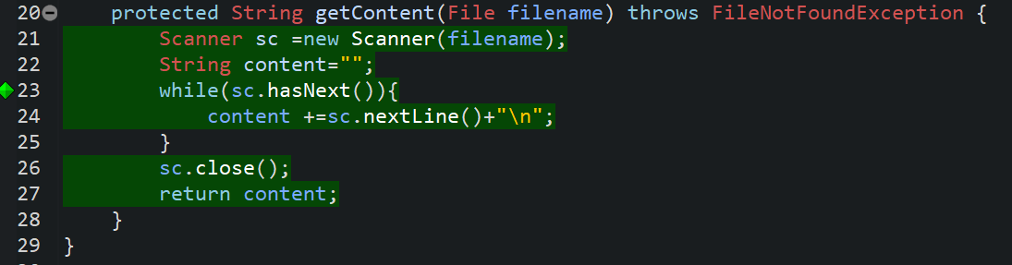
Loop Coverage

Slide 16
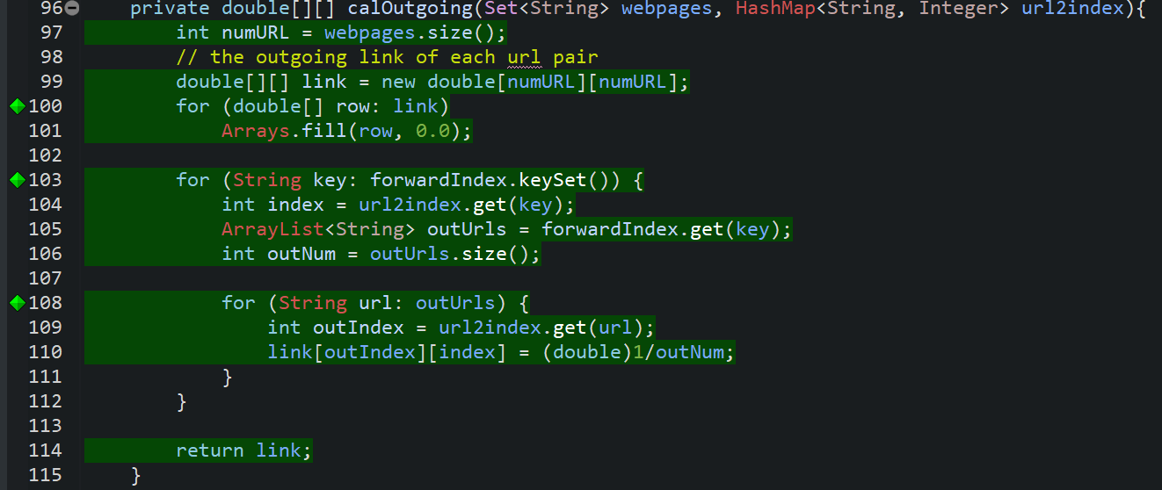
Path Coverage

Slide 17
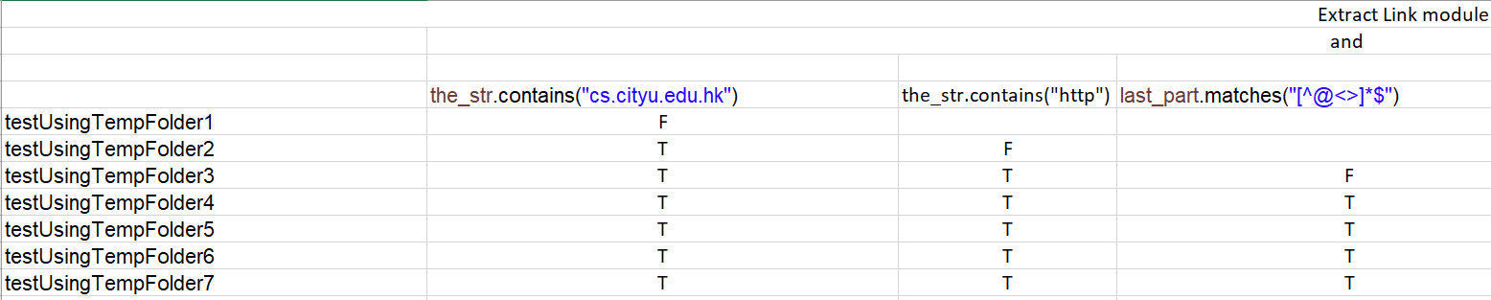
MC/DC Predicate Testing

